Slide 1

Introduction to Length-Based SPR Assessment
Jeremy Prince
January 2021
biospherics@ozemail.com.au

Slide 2
Life History Parameters
&
Life History Ratios
Notes:
Introduction to the Concept of Life History Parameters & Life History Ratios (LHR)
In this section we want people to understand the concept of the basic life history parameters used to describe the elements of a animals life cycle or life history: growth, reproduction and longevity, which the LBSPR uses in the form of ratios. Dividing one parameter by another to compute Life History Ratios (LHR).

Slide 3
Growth - Length
L∞
k
t₀
Notes:
Fisheries biologists and stock assessments tend to assume every fish population is unique, and obsess about their individual life history parameters which we use to define how they grow, reproduce and the rate at which they die -off.
Starting here with the process of growth which we commonly describe with the three von Bertalanffy growth parameters.
T-zero –the age at zero size.
L∞ - the asymptotic size individuals would obtain if they grew forever, and
K – the instantaneous annualized rate of growth from T-zero towards asymptotic size L∞ .
The simple way to understand these values is:
T-zero – defines the size at which growth starts – the size of settling larvae, or in sharks the size at which pups are born or hatch from eggs.
L∞ - is the average size adults would reach and stop growing around if they could live forever so
K – is something like an Inverse measure of how many years a fish takes to get from T-zero – L∞ so roughly speaking K=1.0 means it takes one year to grow-up and K=0.1 means it takes about 10 years.
That’s not quite accurate because we are talking about an instantaneous continuous function here, but it gives the idea of how this equation works and what these individual life history parameters mean.
Now lets put it into picture form.

Slide 4

Growth - Length
L∞
k
t₀
Notes:
Juveniles direct all their energy into growing rapidly

Slide 5
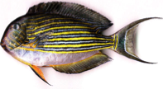
Growth - Length
L∞
k
t₀

Slide 6

Growth - Length
L∞
k
t₀

Slide 7
Growth - Length
L∞
Size of Maturity (L_{m})
k
t₀
Notes:
at the size of maturity (Lm) energy starts being used for reproduction …

Slide 8
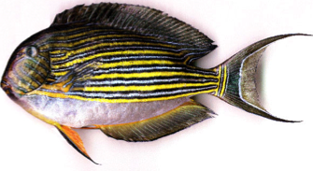
Growth - Length
L∞
Size of Maturity (L_{m})
k
t₀
Notes:
and growth slows …. As L∞ is approached.

Slide 9

Growth - Length
L∞
Size of Maturity (L_{m})
k
t₀
Notes:
And finally if the fish lives long enough it gets to a size where all its energy is being used for reproduction and maintenance and growth becomes extremely slow – asymptotic size as been attained.

Slide 10
Natural Mortality - M
M
Notes:
Next of the life history parameters we want to talk about is natural mortality (M).
This is the instantaneous rate at which fish die off from natural causes; predators, diseases, starvation etc.
It is an inverse measure of their longevity and works something like K in the growth curve.
So roughly speaking with a high M >1 you are more or less an annual species, and with a low M=0.2 some of you have a reasonable expectation of live >20 years.

Slide 11


Natural Mortality - M
Recruitment
M
Notes:
So young fish are created by the reproduction of their parents and recruit to the stock and M defines
the rate at which their cohort declines through natural processes.

Slide 12
Natural Mortality - M
M
Notes:
With fish numbers

Slide 13
Natural Mortality - M
M
Notes:
declining

Slide 14
Natural Mortality - M
M
Notes:
as they grow

Slide 15
Natural Mortality - M
M
Notes:
until their cohort dies out.
Break For Questions ?

Slide 16
Biomass
Notes:
…. biomass by age. We see that in each life cycle cohort biomass (total weight) peaks and then declines through life cycle of every species.
Cohorts start in large numbers when they are individually very small.
Eventually they become individually big but by then their numbers have decline to very low levels.
Some time between those extremes in each population there is an age and size at which a cohort reaches its peak biomass.

Slide 17
Biomass
Optimum Length (L_{opt})
Notes:
Since at least the 1880s the size at which a cohort reaches its peak has been called L-opt - the optimum size for catching fish so growth potential is not wasted

Slide 18
Biomass
Optimum Length (L_{opt})
Size of Maturity (L_{m})
Notes:
L-opt must follow soon after maturation, because when energy starts being put into reproduction growth slows and the rate of natural mortality starts reducing the total biomass of each cohort.

Slide 19
Spawning Potential
Optimum Length (L_{opt})
Size of Maturity (L_{m})
Notes:
Energy cannot be used twice, for fast growth and reproduction. As energy is diverted into cumulative reproductive output (or spawning potential shown here in blue) the processes of mortality inevitably overcome the slowing rate of growth.
This is a classic growth and decay curve, K-being the rate of growth & M being the rate of decay. So the timing of L-opt in each life cycle is determined by …. The ratio of M and K

Slide 20
SPR and Stock & Recruitment Relationships
Notes:
SPR and Stock & Recruitment Relationships

Slide 21
Spawning Potential Ratio
(SPR)
Notes:
Introducing the concept of:
Spawning Potential Ratio (SPR)

Slide 22
Spawning Per Recruit (SPR)
Also known as: Spawning Potential Ratio, Eggs per Recruit, Proportion Lifetime Egg Production
Definition: Proportion of unfished spawning allowed by harvest policy (Walters & Martell 2004)
Indicator of relative fishing pressure (F/M) rather than Biomass (B).
Mace and Sissenwine (1993) – Review and meta-analysis of generic SPR reference points for teleosts. E.g. 20% SPR considered the level likely to reduce recruitment.
Recognized in International Law; US, EUU, Australia, NZ etc. (Restrepo 1999)
Notes:
International Reference Points for SPR well established in the literature and recognized by international legal jurisdictions.

Slide 23
Spawning Potential Example
No Fishing
Age 1
5 x 0 eggs
Age 2
3 x 100 eggs
Age 3
2 x 200 eggs
700 eggs
Notes:
Graphical Analogy of the goldfish bowl.
1.Without fishing 700 eggs produced by the captive population

Slide 24
Spawning Potential Example
No Fishing
Fishing
Age 1
5 x 0 eggs
5 x 0 eggs
Age 2
3 x 100 eggs
2 x 100 eggs
Age 3
2 x 200 eggs
1 x 200 eggs
700 eggs
400 eggs
Notes:
Analogy of the goldfish bowl.
2.With fishing population reduced so only 400 eggs produced by the captive population

Slide 25
Spawning Potential Example
SPR = 400/700 = 0.57 or 57%
No Fishing
Fishing
Age 1
5 x 0 eggs
5 x 0 eggs
Age 2
3 x 100 eggs
2 x 100 eggs
Age 3
2 x 200 eggs
1 x 200 eggs
700 eggs
400 eggs
Notes:
Analogy of the goldfish bowl.
3. Estimation of SPR = Fished Reproductive potential (400 eggs) / Unfished Reproductive potential (700 eggs )
400/700 = 0.57 or 57% SPR

Slide 26









Human Populations
More than 2.1 Children per couple
Population
Growth
Replacement Level
Population Stable
2.1 Children per couple
Less than 2.1 Children per couple
Population
Decline
Notes:
Plain English explanation of the concept of Spawning Potential Ratio or Spawning Per Recruit (SPR) with this analogy to the Human Reproductive Index (HRI
Which is simply the average number of children surviving to adulthood per human couple
If each couple has 2.1 surviving to adulthood a population replaces itself and sustains itself without growth.
This is the Replacement Level for human populations, above this rate populations grow below 2.1 children per couple human populations fall.
The concept of the Human Reproductive Index is analogous to the the concept for marine species of the rate of SPR.
Returning to distinction between SPR & Biomass indicators. A small island with a small population like Fiji can have high HRI and a rapidly growing population , while a huge country like China can have a massive population and low HRI so that its population is declining.

Slide 27







SPR: Spawning Potential Ratio or Spawning per Recruit
Population
Growth
More than 20% SPR
20% SPR
Population Stable
Replacement Level
Less than 20% SPR
Population
Decline
Notes:
With marine populations the equivalent concept to HRI is SPR.
With marine species, unfished populations live out their natural life span and complete 100% of their natural potential for spawning = 100% SPR
Fishing reduces the average life span in the population (fish get caught) reducing the natural potential for Spawning i.e. <100%SPR
International research suggests that 20% is generally the Replacement Level for most marine species – equivalent to 2.1 children per couple
If on average stocks are allowed less Spawning than the Replacement Level (20% SPR) their biomass and eventually recruitment will decline.
Allowed more spawning than this and most species should be able to rebuild towards equilibrium with carrying-capacity.

Slide 28
Internationally accepted SPR values corresponding to Reference Points used by conventional stock assessment methods
Reference Points |  | SPR Values
Limit Reference Point |  | 20%
Lower (Target) MSY |  | 30%
Upper (Target) MSY |  | 40%
Precautionary MSY / MEY |  | 50%
Precautionary / Rebuild SPR |  | 60%
Notes:
International Reference Points for Spawning Potential
Target Reference Point: Maximum Economic Yield:
High catch rates, optimal body size, optimal production
50% Spawning Potential
Target Reference Point: Maximum Sustainable Yield:
Sub-optimal catch rates, sub-optimal body size, maximum catch
30% Spawning Potential
Limit Reference Point: Potential Impairment of Recruitment
Low catch rates, low body size & declining catch
20% Spawning Potential
Break For Questions ?

Slide 29
SPR and Stock & Recruitment
Notes:
The idealized relationship between adult stock on x-axis & the young fish they expected to produce for future recruitment to the fish stock (recruitment) is shown on the Y-axis.
The units on both axis are arbitrary, this is just an illustrative figure showing a commonly assumed form ro relationship between stock (x-axis ) and recruitment (y-axis)

Slide 30
SPR and Stock & Recruitment
Spawning Potential ~ 100%
Notes:
100% SPR in the virgin unfished population producing maximum recruitment

Slide 31
SPR and Stock & Recruitment
Spawning Potential ~ 100%
Spawning Potential ~ 20%
Notes:
Around 20% SPR - the replacement level of SPR and inflexion point is expected below which recruitment is expected to decline.

Slide 32


SPR and Stock & Recruitment
Spawning Potential ~ 100%
Spawning Potential ~ 20%
Notes:
Unfished population – 100% SPR – maximum recruitment

Slide 33
SPR and Stock & Recruitment
Spawning Potential ~ 100%
Spawning Potential ~ 20%
Notes:
Fished population with <100% SPR but >20% SPR and high level of recruitment keeping the population stable and productive.

Slide 34
SPR and Stock & Recruitment
Spawning Potential ~ 100%
Spawning Potential ~ 20%
Notes:
Fished population with ~20% SPR reduced recruitment around replacement level population stable still stable but no longer productive.

Slide 35
SPR and Stock & Recruitment
Spawning Potential ~ 100%
Spawning Potential ~ 20%
Point of Impaired Recruitment (PIR)
Notes:
Fished population with <20% SPR collapsing recruitment leading to collapsing population and productivity.

Slide 36
Fishing Down Size Structure in Populations
&
Length Based Assessment
Notes:
Introducing the concept of fishing down the size structure of populations & length-based assessment.
The way fishing depletion changes the size composition of populations is well understood and widely used in stock assessment.
It is referred to as fishing down the size structure.

Slide 37




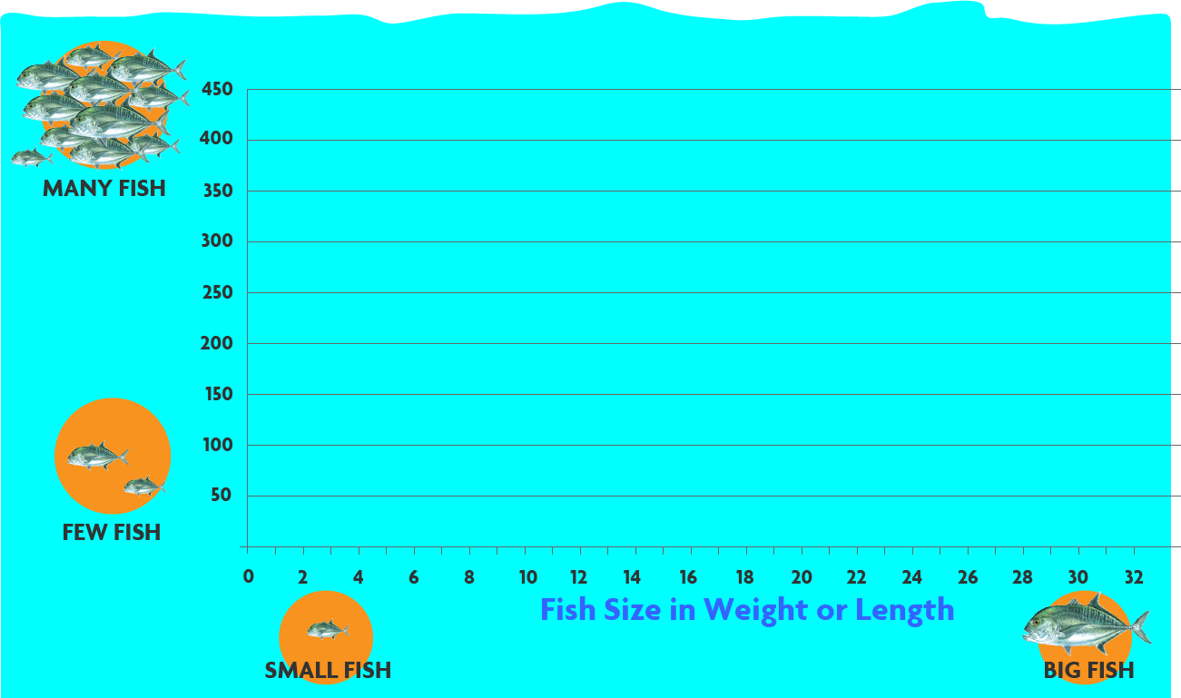
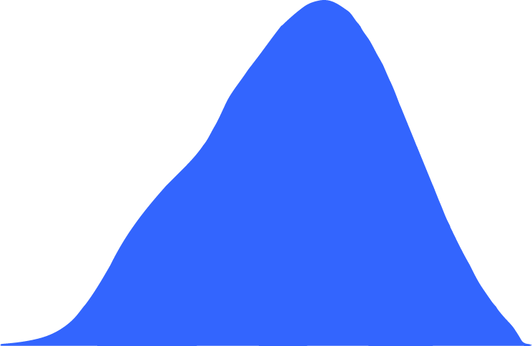




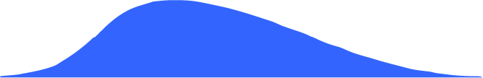

Size of Maturity
Notes:
Shown here is a length frequency histogram. Again the units on the axis are arbitrary and this figure is just for illustration. But this form of graph – the length frequency histogram is central to the application of Length-based SPR assessment. On the bottom we show the length of the fish, the smallest fish on the left and the biggest fish on the right. Up the side we show the number of fish of each size that that we count, from few fish (zero) at the bottom up to many fish (450) fish of a size at the top. And here we also show the size at which the fish mature – become adults.
Next we show the sizes of the fish that we would see if there was no fishing. In this picture we see in our sample that we have measured about 425 fish of size 20, but we measure zero fish of size 30 & 32. That is because like humans every fish has an average adult size and a maximum adult size, and even if there is no-one fishing they stop growing and die-off before getting above that maximum size which in this picture is about 29. On the other hand normally we don’t see the smallest fish in our samples because they are not caught by the fishing gear, either because the hooks or nets are too big, or because many small fish hide away in the coral, or seagrass or shallows to stay safe from being eaten by the big adult fish out on the reef.
So when fishing starts some of the fish get caught and eaten before they can grow to full size and old age
And as fishing gets heavier more fish are caught before reaching full size, and this has the biggest effect over on the right and in the middle of this graph where you see there are now a lot less of the biggest size classes of fish. And see the way the average size of the fish is getting smaller, so that it looks as if the fish are now smaller over all. This is not because the fish are growing any differently, it is just because the fish don’t get to live as long as before, or grow as big; most of them are now being caught before they get big and old.
This process goes on the longer there is fishing and the more fishing that occurs. Until eventually no fish ever get as big as they used to in the past. This is what often creates arguments in fishing communities between the old fishers who remember catching much bigger fish, and the young fishers who have never seen fish that big and think the old fishermen are exaggerating about the size of the fish the old people used to catch. But over on the left, the young small fish remain much the same as long as there is at least 20% of spawning going on, enough to keep the supply of young fish steady.
So as long as there is enough spawning almost all the change will be in the number and size of the biggest fish.
But eventually when the level of spawning goes below 20%, the supply of little fish starts failing and then you see change on the left as well, with the last lot of fish growing bigger and getting fewer and fewer,
Until at last they are caught out and the population goes local extinct.

Slide 38

Size of Maturity
20% SpPR
Notes:
The LBSPR method uses the way fishing changes the size of fish to estimate how much spawning is occurring now.
These type of data are commonly used in stock assessment, but until our break through trends in the way size structure changed over time were interpreted with a time series of catch and effort data and with biological information used as one element to estimate biomass trends. One of the reasons for using them in this way was that we so rarely have measurements of the unfished size structure so we have no base-line to compare the fished down size structure against. So we haven’t be able to do before and after comparisons which has forced us to compare the trend in fishing down with catches to help estimate the biomass trend.
Our break through with LBSPR has been to realize that with the Life History Ratio of a species or family group (which we are going to talk about next) we can now hind-cast the unfished shape of population size structures would have been.
This enables simple snap-shot - ‘before and after’ - assessments .
All we need are:
1. Estimates of a the life history ratios which are typical for a species, genus or family
2. local estimate of size of maturity (the size at which the fish become adults)
3. the current size composition of a fish stock (the current fished state) and a we can estimate how much spawning potential (SPR)
And we can make a simple snapshot assessments of SPR. The amount of reproductive potential being left in a fish stock by fishing.
Break For Questions ?

Slide 39
Life History Ratios (LHR)
M/k
L_{m}/L∞
Beverton (1963): “The essential biological characteristics which determine the response of the stock to fishing pressure are contained in the magnitude of M/k and L_{m}/L∞”
Notes:
Most fisheries biologists spend their careers modeling populations in terms of these individual parameters.
But in the 50s and 60s Beverton and Holt were thinking about dividing them by each other and use the life history parameters as life history ratios.
Beverton wrote that; “the essential biological characteristics determining responses to fishing pressure are contained in the dimensionless ratios - M/k and L_{m}/L∞.
NB: It is not the individual life history parameters that are most important… it is the life history ratios that matter.

Slide 40
Holt Life History Ratios (LHR)
M/k
L_{m}/L∞
Beverton (1963): “The essential biological characteristics which determine the response of the stock to fishing pressure are contained in the magnitude of M/k and L_{m}/L∞”
Holt (1958): LHR are more informative for data-poor stock assessment than LH parameters because physiological constraints make them are less variable across species ranges and taxonomic groups
Notes:
While Holt said the Life History Ratios are more informative for data-poor stock assessment than the individual parameters, because physiological constraints make them less variable across taxonomic groupings and species’ ranges.
So what’s behind these statements?

Slide 41
Spawning Potential
M/k
Optimum Length (L_{opt})
Size of Maturity (L_{m})
Notes:
…. M/K ….. K being the rate of growth. and M the rate of decay ..
Obviously, as noted by Jensen and Charnov, this is an important ratio in the life cycle because having reproduction and L-opt coincide optimizes evolutionary fitness,
It doesn’t make sense to have your cohort biomass peak and then decline to low levels before you start breeding. If you left breeding too late in your life cycle you would go extinct. Everyone would be dead before they breed. A bit like we see in some ageing human populations,
But in terms of bio-energetics it can’t be any other way, because it is the diversion of energy away from growth and into reproduction that makes growth slow so that cohort biomass begins to decline.
So L-opt in the life cycle of a species is a function of the life history ratio M/K, and is also closely related to Lm – the size of maturity.
And together M & K basically define asymptotic size in relative terms so it is inevitable that …..

Slide 42
Spawning Potential
M/k
Optimum Length (L_{opt})
Size of Maturity (L_{m})
L_{m}/L∞
Notes:
The life history ratio L_{m}/L∞ is also fundamentally correlated with M/K.
Evolution and bio-energetics determine these correlations of Life History Ratios exist.
Break For Questions ?
Beverton & Holt called the Life History Ratios dimensionless numbers which varied across species, genus and families defining different life history strategies.

Slide 43
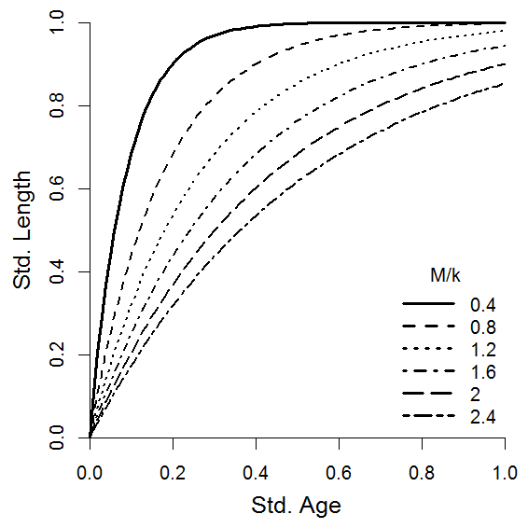
M/k and standardised vB curve
Standardised von Bertalanffy growth curve
Notes:
Here we standardize the growth curves to the life cycle.
We start with 1000 recruits and plot growth to the last individual relative to asymptotic size on the y-axis.
On the x-axis age is plotted relative to maximum age – the age at which unfished cohorts have declined from 1000 individuals to the last survivor
You see M/k defines the experienced shape of the growth curve.
By definition all von Bertallanfy curves have the same arching and asymptotic form. But M/K determines whether or not cohort members are still surviving by the time asymptotic size is attained.

Slide 44
M/k and standardised vB curve
High M/k
Standardised von Bertalanffy growth curve
Notes:
R-strategists with high M/k experience a relatively flat form of growth, and continue growing through life.
For them asymptotic size is aspirational rather than experienced, their cohorts die out before their growth slows down appreciably.

Slide 45
M/k and standardised vB curve
Low M/k
Standardised von Bertalanffy growth curve
Notes:
While low M/k equilibrium species have a square form of growth, individuals commonly reach asymptotic size and spend many breeding cycles growing slowly, and the many adult cohorts have overlapping size ranges so cohorts stack up on each other in similar size classes
So r- and K- strategists have differing size compositions.

Slide 46
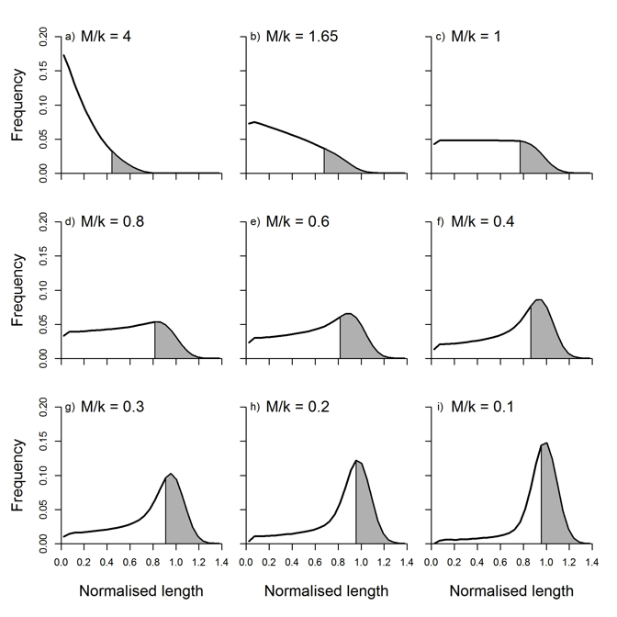
Categorizing Species by Life History Strategy
M/k = 4.0
R-strategists
M/k = 1.0
Prince et al. (2014) ICES J. Mar. Res. doi:10.1093/icesjms/fsu011
Notes:
With our breakthrough we can now hind-cast the original unfished size composition of any fish stock.
Here we simulate length frequency histograms changing just the value of M/K
Here we think about size in entirely relative terms, along the x-axis we plot size relative to asymptotic size (L∞).
In this graph the grey shading denotes adults defined by Beverton’s correlation between M/k & L_{m}/L∞
Here we see the link between the shape of a population’s size composition and life history strategy defined by M/K.
R-strategists with M/K>1.0 – are often called weed, or boom and bust species. They have high intrinsic rates of population growth and typically unstable population dynamics. R-strategist start breeding at relatively small sizes, but continue growing relatively fast throughout adult life. Adults generally die small, well before they reach asymptotic size, few get really big, so they don’t form adult modes even in the unfished state. These species are often the prey of higher order predators.

Slide 47
Categorizing Species by Life History Strategy
M/k = 4.0
R-strategists
M/k = 1.0
K-strategists
M/k = 0.8
M/k = 0.4
Prince et al. (2014) ICES J. Mar. Res. doi:10.1093/icesjms/fsu011
Notes:
K-strategist M/K <1.0 tend to have stable populations matched to the carrying capacity of their habitat. These species are often higher order predators, or bigger bodied herbivores and planktivores. They grow to almost full adult size before maturing, but mature at a relatively big size early in their often extended life cycle, and then participate in many breeding cycles without growing much.

Slide 48
Categorizing Species by Life History Strategy
M/k = 4.0
R-strategists
M/k = 1.0
K-strategists
M/k = 0.8
M/k = 0.4
K-strategists
M/k = 0.5
M/k = 0.1
Prince et al. (2014) ICES J. Mar. Res. doi:10.1093/icesjms/fsu011
Notes:
Their unfished populations are characterized by a prominent adult modes, because they have many adult cohorts growing slowly around asymptotic size stacking up on each other in the length frequency histograms.
Our conceptual leap is to realise that M/K puts a number on how much of an R- or K- strategist you are, and that this is linked to size structure. Our work is fleshing out the intuitions of the pioneers Beverton & Holt.
With this understanding the potential is that we no longer need detailed biological studies of each and every fish population, or historic data. We simply need to categorize the life history strategies of species and families in terms of M/k, and conduct studies of size of maturity and size composition , to be able to complete simple snapshot assessment of SPR
So in this light for the last 4 years we have been combing the age and growth literature and developing a massive meta-analysis of life history ratios so that we can test Holt’s idea that the LHR are characteristic of entire groups of species with shared life history strategies. And it does turn out to be true. We don’t need detailed biological studies in each location for each fishery.
These life history ratios are shared across entire family groupings of species. But this is getting into tomorrow’s seminar on the application of LB-SPR.
Here we have finished laying out the basic theory underlying the approach.

Slide 49
High Quality (QI>-0.2) LHR estimates produced by meta-analysis (Prince et al. in press)

